Slide 1
CSI342 Systems Analysis and Design
Lecture 6B – Object Oriented Modelling

Slide 2
Learning Objectives
At the end of this lecture, students are expected to:
Be able to explain activity diagrams
Discuss sequence diagrams
Describe class diagrams

Slide 3
Business Process Modeling with Activity Diagrams
Best practice when modeling business processes
When modeling a business process, stay focused on that specific process. If tasks associated with other business processes are identified, record them on a to-do-list and continue with the current business process modeling
Remember that a business process model is an abstraction of reality. Hence you don’t have to include every minor task in the current description of the business process.
Too many details at the early point of evolution of a an information system could create confusion and could prevent the analyst from solving the underlying problem being addressed by the new system

Slide 4
Elements of an Activity Diagram
Activity diagrams portray the primary activities and the relationships among the activities in a process
Elements
Actions – Simple non decomposable piece of behavior
Is labeled by its name
Symbol is a rounded rectangle e.g.
Activity – Used to represent a set of actions
Is labeled by its name
Symbol is a rounded rectangle e.g.
Object Node – Used to represent an object that is connected to a set of object flows
Is labeled by its class name, Symbol is rectangle e.g.
Action
Activity
ClassName

Slide 5
Elements of an Activity Diagram
Control Flow - Shows the sequence of execution; uses the arrow symbol
Object flow – shows the flow of an object from one activity (or action) to another activity (or action); symbol is a dotted arrow
Initial node - Portrays the beginning of a set of actions or activities; Symbol is a small dark circle
Final activity node – used to stop all control flows and object flows in an activity (or action ); symbol is a small circle marked with an x inside
Final flow node – used to stop a specific control or object flow; symbol is a small double circle

Slide 6
Elements of an Activity Diagram
Decision node – Used to represent a test condition to ensure that the control flow only goes down one path.
Is labeled with the decision criteria to continue down the specific path
E.g.
Merge node – Used to bring back together different decision paths created using a decision node
criteria
criteria

Slide 7
Elements of an Activity Diagram
Fork node – Used to split behavior into a set of parallel or concurrent flow of activities (or actions).
E.g.
Join node - Used to bring back together a set of parallel or concurrent flows of activities (or actions)

Slide 8
Elements of an Activity Diagram
Swimlane (A box closing activities or actions) – Used to break up an activity diagram into rows and columns to assign the individual activities (or actions) to individuals or objects that are responsible for executing the activity (or action)
Is labeled with the name of the individual or object responsible
Any activity without any outflows or inflows should be challenged
Swimlane

Slide 9
Creating Activity Diagrams
Created by asking what happens first, what happens second, and so on
Must determine what activities are done in sequence or in parallel
The sequence of activities can be determined from physical data flow diagrams
Can be created by examining all the scenarios for a use case
Notes:
The sequence of activities can be determined from physical data flow diagrams—look for places that decisions are made, and ask what happens for each of the decision outcomes.
Can be created by examining all the scenarios for a use case—each path through the various decisions included on the use case is a different scenario.

Slide 10
Steps in Creating an Activity Diagram
Choose a Business Process that was previously identified to model . Review your requirements for this
Identify the set of Activities necessary to support the business process
Identify the control flows and nodes necessary to document the logic of the business process (e.g. where activity diagrams require a decision and merge nodes)
Identify the object flows and nodes necessary to support the logic of the business process.
Lay out and draw the diagram
Check for practical examples of Activity diagram in text books or online

Slide 11
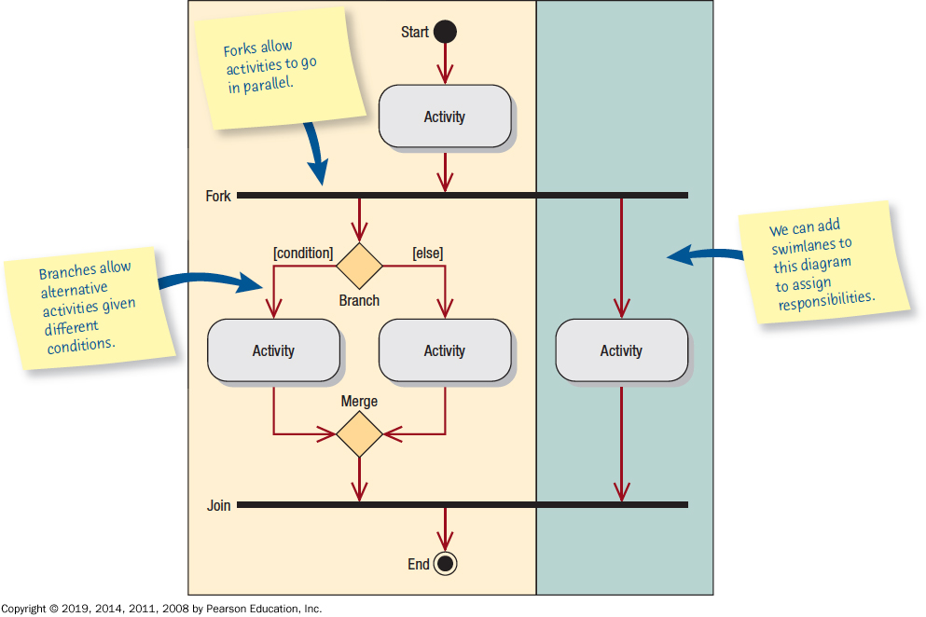
Activity Diagram Symbols

Slide 12
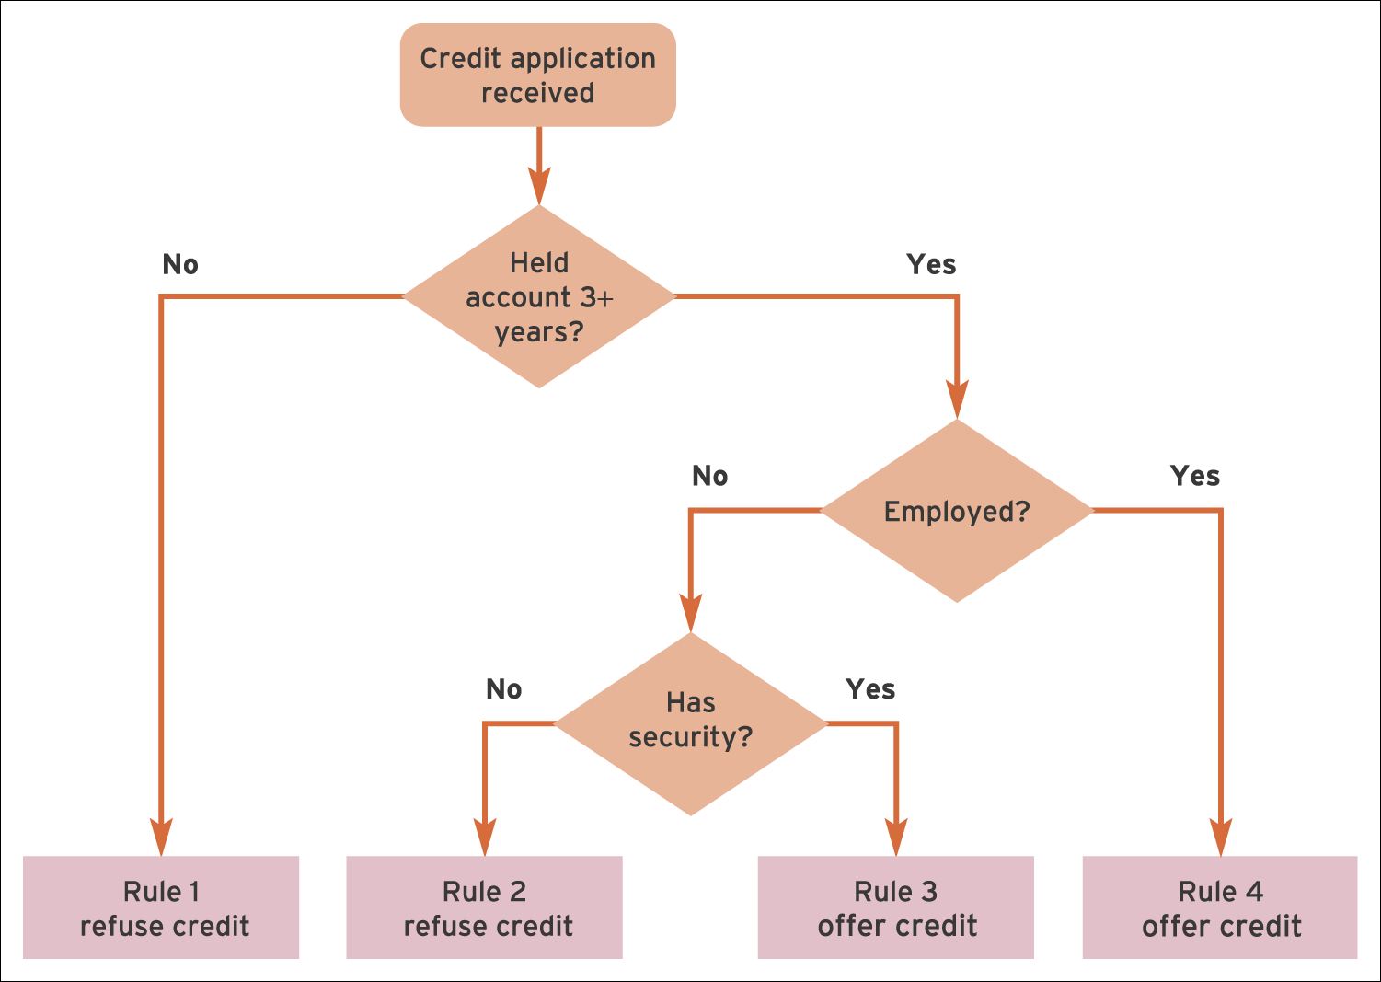
Elements of an Activity Diagram

Slide 13
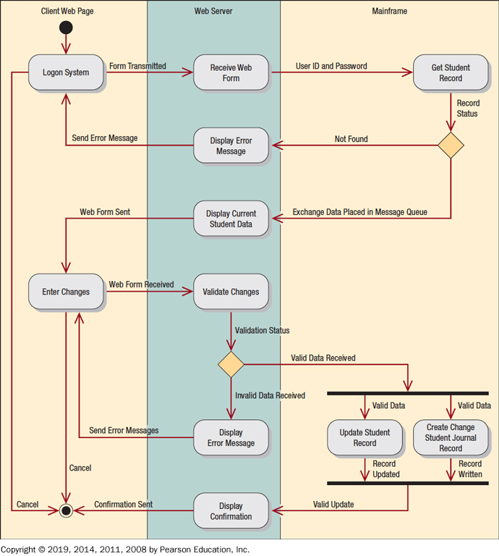
Activity Diagram Shows Three Swimlanes: Client Web Page, Web Server, and Mainframe

Slide 14
Sequence Diagrams
Illustrate a succession of interactions between classes or object instances over time
Often used to show the processing described in use case scenarios
Used to show the overall pattern of the activities or interactions in a use case
objectName: A name with a colon after it represents an object.
:class A colon with a name after it represents a class.
objectName: class A name, followed by a colon and another name,represents an object in a class
Notes:
In practice, sequence diagrams are derived from use case analysis and are used in systems design to derive the interactions, relationships, and methods of the objects in the system.
Each use case scenario may create one sequence diagram, although sequence diagrams are not always created for minor scenarios.

Slide 15
Create Sequence Diagrams
Include the actor from the use case diagram
Define one or more interface classes for each actor
Each use case should have one control class
Examine the use case to see what entity classes are required
The sequence diagram may be modified when doing detailed design

Slide 16
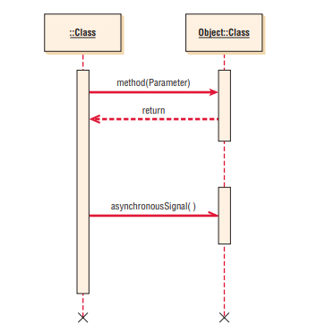
Symbols in Sequence
Notes:
During the systems design phase, the sequence diagrams are defined to derive the methods and interactions between classes.

Slide 17
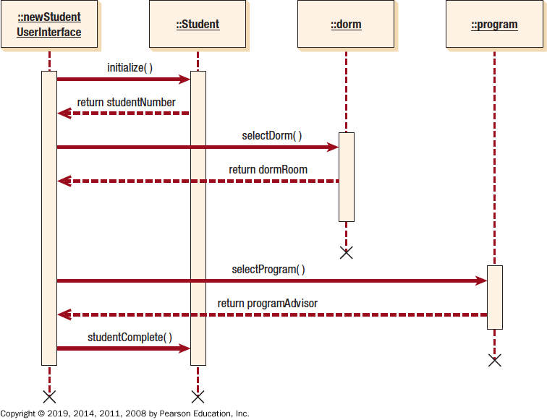
A Sequence Diagram for Student Admission:
Notes:
During the systems design phase, the sequence diagrams are defined to derive the methods and interactions between classes.

Slide 18
Class Diagrams (1 of 2)
Show the static features of the system and do not represent any particular processing
Show the nature of the relationships between classes
Show data storage requirements as well as processing requirements

Slide 19
Class Diagrams (2 of 2)
Classes
Attributes
Private
Only available in the object. This is represented on a class diagram by a minus sign in front of the attribute name.
Attributes are only available to outside objects through the class methods, a technique called encapsulation, or information hiding.
Public
It is visible to other objects outside its class. Under rare circumstances, an attribute is public.
Protected
Attributes may also be protected, indicated with a pound symbol (#). These attributes are hidden from all classes except immediate subclasses.
Methods
Notes:
Classes—represented by a rectangle on the class diagram.
Attributes—what the class knows about the characteristics of the objects:
Private—only available in the object
Public—visible to other objects outside its class
Protected—hidden from all classes except immediate subclasses
Methods—small sections of code that work with the attributes:
Standard—basic things that all classes of object know how to do
Custom—designed for a specific class

Slide 20
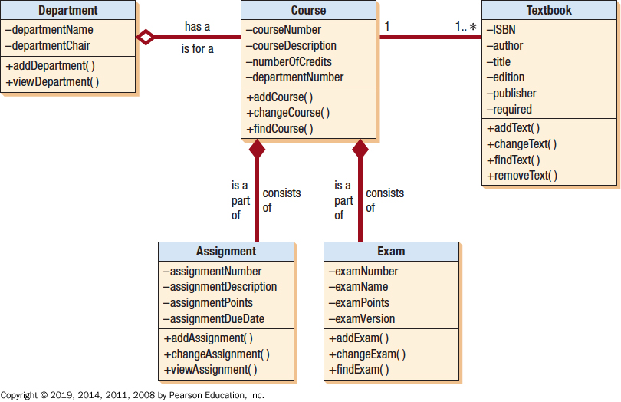
A Class Diagram for Course Offerings

Slide 21
Types of Classes
Entity classes
Interface Classes
Abstract classes
Control classes

Slide 22
Types of Classes
Entity classes
Represent real-world items such as people, things, and so on.
The entities represented on an entity-relationship diagram

Slide 23
Types of Classes
Interface or Boundary Classes
Provide a means for users to work with the system
Human interfaces may be a display, window, Web form, dialogue box, touch-tone telephone, or other way for users to interact with the system
System interfaces involve sending data to or receiving data from others systems. This may include databases in the organization.

Slide 24
Types of Classes
Abstract Classes
Linked to concrete classes in a generalization/specialization relationship
Provides implementations for all of the abstract methods in its parent class.
Cannot be directly instantiated
Control Classes
Used to control the flow of activities
Many small control classes can be used to achieve classes that are reusable

Slide 25
Messages
Used to send information by an object in one class to an object in another class
Acts as a command, telling the receiving class to do something
Consists of the name of the method in the receiving class, as well as the attributes that are passed with the method name
The methods may have logic defined using structured English, a decision table, or a decision tree
May be thought of as an output or an input
Notes:
Consists of the name of the method in the receiving class, as well as the attributes that are passed with the method name—the receiving class must have a method corresponding to the message name.
May be thought of as an output or an input—the first class must supply the parameters included with the message and the second class parameters.

Slide 26
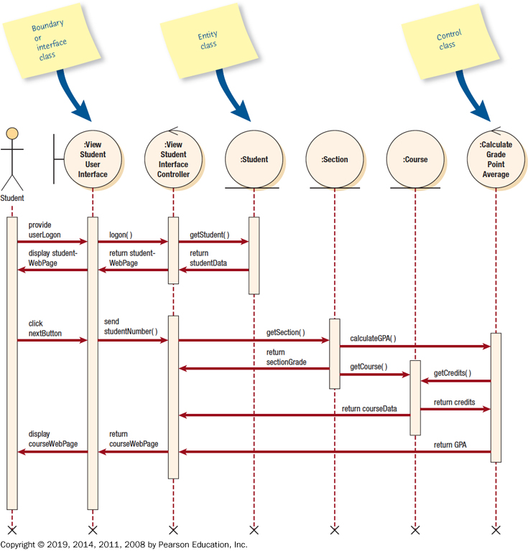
A Sequence Diagram for Using Two Web Pages: One for Student Information, One for Course Information

Slide 27
Relationships (2 of 2)
The connections between classes
Associations
Whole/part
Notes:
Associations—a structural connection between classes or objects.
Whole/part—when one class represents the whole object and other classes represent parts.

Slide 28
Associations
The simplest type of relationship
Association classes are those that are used to break up a many-to-many association between classes
An object in a class may have a relationship to other objects in the same class, called a reflexive association
A zero represents none, a one represents one and only one, and an asterisk represents many. The notation 0..1 represents from zero to one, and the notation 1..* represents from one to many.

Slide 29
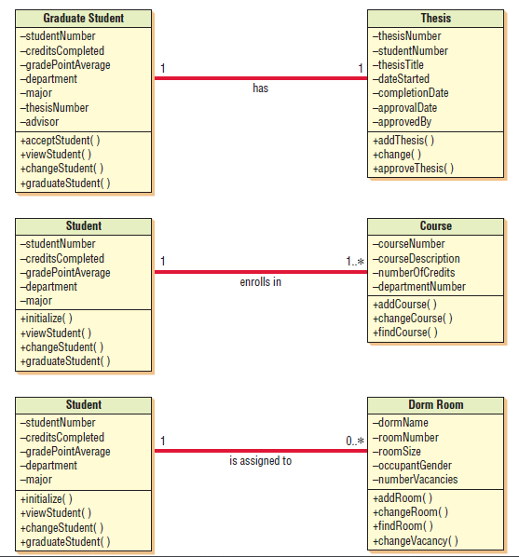
Associations

Slide 30
Whole/Part Relationships
Whole/part relationships are when one class represents the whole object and other classes represent parts. The whole acts as a container for the parts.
These relationships are shown on a class diagram by a line with a diamond on one end. The diamond is connected to the object that is the whole.
A whole/part relationship may be an entity object that has distinct parts, such as a computer system that includes the computer, printer, display, and so on, or an automobile that has an engine, brake system, transmission, and so on.
Whole/part relationships may also be used to describe a user interface, in which one GUI screen contains a series of objects such as lists, boxes, or radio buttons, or perhaps a header, body, and footer area. Whole/part relationships have three categories: aggregation, collection, and composition.
Notes:
When one class represents the whole object, and other classes represent parts—the whole acts as a container for the parts.

Slide 31
Whole/Part Relationships
When one class represents the whole object, and other classes represent parts
Categories
Aggregation
A “has a” relationship
Provides a means of showing that the whole object is composed of the sum of its parts
Collection
Consists of a whole and its members
Members may change, but the whole retains its identity
A weak association
Composition
The whole has a responsibility for the parts, and is a stronger relationship
If the whole is deleted, all parts are deleted
Notes:
When one class represents the whole object, and other classes represent parts—the whole acts as a container for the parts.

Slide 32
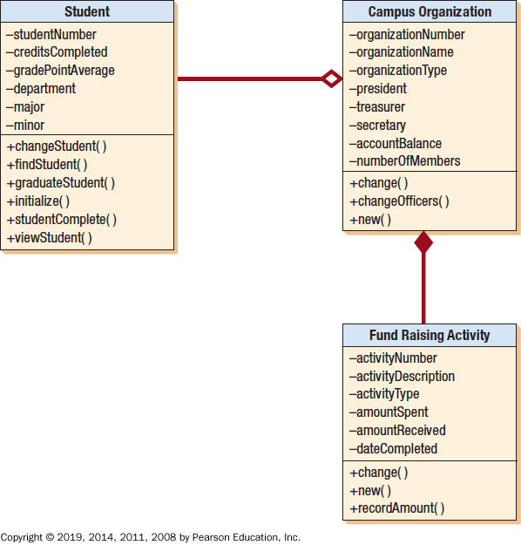
An Example of Whole-Part and Aggregation Relationships

Slide 33
Statechart Diagrams (1 of 2)
Used to examine the different states that an object may have
Created for a single class
Objects are created, go through changes, and are deleted or removed
Objects
States
Events
Signals or asynchronous messages
Synchronous
Temporal events
Notes:
Event—something that happens at a specific time and place.
Signals or asynchronous messages—occur when the calling program does not wait for a returning message.
Synchronous messages—calls to functions or subroutines.
Temporal events—occur at a predetermined time.

Slide 34
Statechart Diagrams (2 of 2)
Created when:
A class has a complex life cycle
An instance of a class may update its attributes in a number of ways through the life cycle
A class has an operational life cycle
Two classes depend on each other
The object’s current behavior depends on what happened previously
Notes:
Statechart diagrams are not created for all classes.

Slide 35
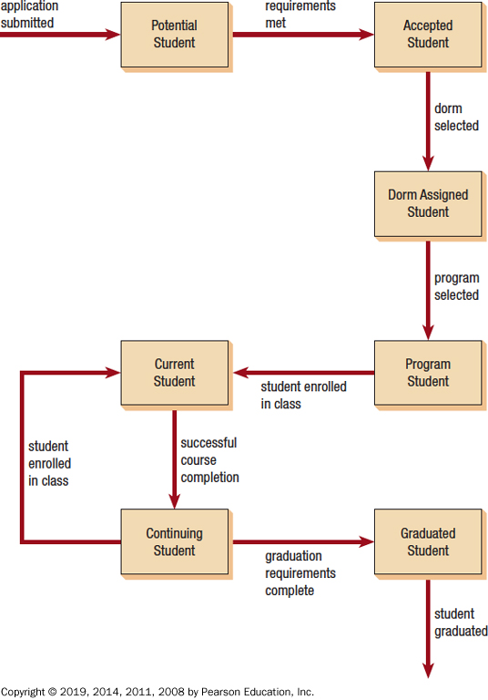
A Statechart Diagram Showing How a Student Progresses from a Potential Student to a Graduated Student

Slide 36
Packages
Containers for other U M L things
Show system partitioning
Can be component packages
Can be physical subsystems
Use a folder symbol
May have relationships
Notes:
Containers for other UML things—such as use cases or classes.
Show system partitioning—indicating which classes or use cases are grouped into a subsystem (logical packages).
Can be component packages—contain physical system components, or use case packages, containing a group of use cases.
Use a folder symbol—with the package name either in the folder tab or centered in the folder.
May have relationships—may include associations and inheritance.

Slide 37
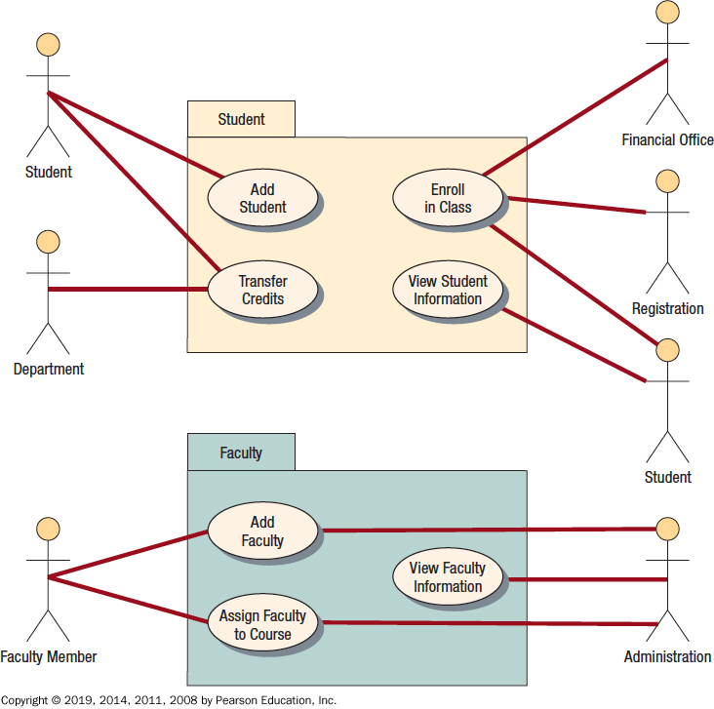
Use Cases Can Be Grouped into Packages

Slide 38
Putting U M L to Work
The steps used in U M L are:
Define the use case model
Continue U M L diagramming to model the system during the systems analysis phase
Develop the class diagrams
Draw statechart diagrams
Begin systems design by refining the U M L diagrams
Document your system design in detail
Notes:
The analyst will initially use the UML toolset to break down the system requirements into a use case model and an object model. The use case model describes the use cases and actors. The object model describes the objects and object associations, and the responsibilities, collaborators, and attributes of the objects.
“Putting a project on paper before coding will wind up costing less in the long run. It’s much cheaper to erase a diagram than it is to change coding.”

